Slide 1
The Direct Care Worker’s Role in Identifying and Addressing Pain in Older Adults
Funded by a grant from the SCAN Foundation
Developed by
Linda J. Redford, R.N., Ph.D
University of Kansas Medical Center
In collaboration with Aging Services of California, Sacramento, CA and LeadingAge Center for Applied Research, Washington, D.C.

Slide 2
MODULE 1 Identifying Pain in Your Residents

Slide 3
At the end of this module, you will be able to--
Define pain.
List at least three common causes of pain in older adults.
Identify how common pain is in nursing home residents.
Describe at least four consequences of poorly managed pain for the older person.

Slide 4
At the end of this module, you will be able to--
State six questions you should ask when conducting a pain assessment on residents who can tell you how they feel.
Describe at least five signs of pain in older adults.

Slide 5
HOW COMMON IS PAIN
45% to 83% of people >65 experience pain
60% to 70% of nursing home residents have significant pain, one third in constant pain
32% to 36% of older people in the community have pain
Core Curriculum for Pain Management Nursing, 2002
Notes:
Often residents of nursing homes are unable or unwilling to admit they are having pain or discomfort. Some residents are too confused or have communication problems that keep them from being able to tell you they are in pain. Others may feel it is just a part of growing old and that nothing can be done, while others may not want to admit pain because they fear becoming “addicted” to pain medications. The direct care worker must always be alert to the signs of pain and discomfort that are discussed in this module.

Slide 6
What is PAIN?
Pain is whatever and wherever the sufferer says it is.
Notes:
People experience pain in many ways. Each person’s perception and expression of pain is shaped by such factors as their biological makeup, their previous experiences with pain, and their culture. The rule to remember is that pain is whatever the sufferer says it is.
Ask participants to think about the worst pain they have ever had? Ask some of them to describe the pain. Next ask them to reproduce that feeling of pain in their bodies. Even if we have searing memories of having pain, it is very rare that one can reproduce the feeling after it is gone.

Slide 7
Pain Defined
A sensation that hurts– causing discomfort, distress, or even agony.
The pain may be from physical causes or from mental anguish.
Pain is difficult to define because it a sensation that is different for each individual.
Perception of pain is influenced by memory, emotions, and expectations.
Notes:
Pain is a very individual event. How people perceive, experience, and respond to pain is influenced by characteristics of their nervous system, their past experience with pain, and cultural expectations about pain.
If people have had long periods of severe pain, we know that the nerves become sensitized. When this happens, movement or activities that would normally not cause pain can be very painful. Pain tolerance is also very individual. Conditions that cause annoying discomfort for some people can cause debilitating pain for others.
How people express pain also varies across individuals and can be culturally influenced. In some cultures, it is considered appropriate to freely express pain, while more stoic cultures discourage outward expressions of pain. This “suck it up and get on with it” attitude means that people can be in severe pain and refuse to acknowledge it. In these cases, it is important that health care providers be alert to nonverbal signs of pain– stiffening and guarding with movement, wincing, being unusually quiet or immobile.

Slide 8
Goals of Pain Management
Improve the person’s ability to do the things (s)he wants to do.
Make the person more comfortable.
Improve the person’s quality of life.
Possibly reduce health care costs.
Notes:
It may not be possible to eliminate all pain, but it is usually possible to make it tolerable. The goal is to improve the individual’s quality of life and ability to conduct desired activities. We know that when pain is controlled, people are likely to heal faster and better. This, in turn, can lower health care costs.

Slide 9
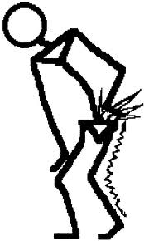
Common Causes of Pain in Older Adults
Arthritis & Osteoporosis
Pain and swelling in joints
Back pain
Leg Pain
Notes:
Arthritis is a common cause of pain as people age. Half of all adults over age 65 have arthritis. Arthritis causes pain in the joints and back making it difficult for people to do daily activities and putting them at risk of falling.
Osteoporosis is a disease that can affect both men and women, but women are particularly prone to it. Osteoporosis results in a loss of bone. The vertebra in the back and bones throughout the body become more brittle and susceptible to fracture. This condition often results in back pain and increased likelihood of undetected fractures.

Slide 10
Common Causes of Pain in Older Adults
Decreased blood circulation or damage to the nerves in the feet, legs, hands and arms. (Peripheral vascular disease and diabetic neuropathy)
Notes:
Changes in circulation and sensation in the legs and arms can result from diabetes or vascular disease (disease of the blood vessels). Vascular disease causes pain due to a lack of blood supply to the feet, legs, and/or hands. Diabetic neuropathy results from direct damage to the nerves in the extremities and causes numbness, tingling or a burning or throbbing pain. These conditions not only cause disabling pain, but also put the individual at greater risk of a fall.

Slide 11
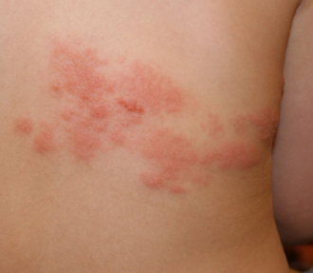
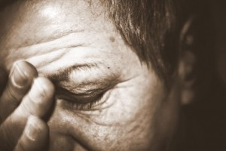
Common Causes of Pain in Older Adults
Shingles
Headaches
Notes:
Shingles are caused by a virus that attacks the nerves and often causes a rash and skin blisters, usually on one side of the body. The virus is the same virus that causes chickenpox. It “sleeps” in the nerve endings in the body forever after someone has chickenpox and can activate to cause shingles. This usually occurs when the person is older and has a weakened immune system due to stress, illness, or medications. The virus cannot cause chickenpox again, just shingles. This condition usually resolves in a few weeks, but can be very painful and sometimes causes pain long after the rash subsides.
Almost everyone has a headache at sometime in their life. Migraines tend to decrease as people age into their 50s and beyond, but headaches can still be debilitating for some older adults and are more likely to be associated with certain diseases/conditions or medications. Sudden severe headaches in a resident should be reported to the nurse immediately. This can be a sign there is bleeding inside the head.

Slide 12
Consequences of Poorly Controlled Pain
Depression
Anger
Poor quality of life
Loss of ability to do daily activities
Impaired relationships with family/friends
Social isolation
Loss of self-esteem
Notes:
Poorly controlled pain has many adverse consequences as are shown on this slide. Pain can generally be controlled or at least kept at a level that does not severely impair the individual’s ability to rest and do usual daily activities. It is important to utilize all means available in our attempts to keep people comfortable and able to function.

Slide 13
Assessing Pain in a Resident Who Can Tell You How They Feel
“Are you having pain or discomfort?
or
“Are you hurting anywhere?”
If the resident says “No”, but you
suspect something is wrong, say-
“Tell me about how you are feeling.”
Notes:
When asking residents about pain or discomfort, it is best to ask them to describe any pain or discomfort they are having. Just asking a person if they have “pain” will not always give you an accurate response. Many older persons deny pain, but will acknowledge that they have discomfort or that they hurt.

Slide 14
Assessing Pain
If a resident says he/she is having pain/discomfort, you need to ask a series of questions and report the answers to the nurse.
Notes:
NEXT SLIDE

Slide 15
What to ask about pain
The word WILDA may help you remember what to ask about pain.
Words (How does it feel? This should be the type/quality of pain as stated in the words of the resident)
Intensity (How much does it hurt? Use pain scales to illicit the degree of pain.)
Location
Duration (When did it start? How long does it last?)
Aggravating/Alleviating factors (What makes the pain better or worse?)
Notes:
The term WILDA will help you remember what to ask of a resident who is experiencing pain.

Slide 16
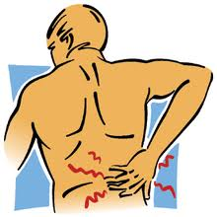
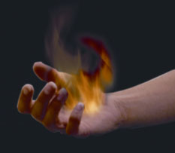
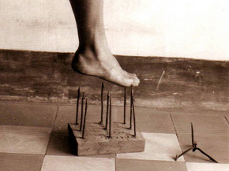
How does the pain feel?
Aching
Burning
Stabbing
Notes:
There are hundreds of words to describe pain. It is best to let the resident use their own words, but if they are having difficulty describing it you may need to give them some examples. It is important to know the type of pain, because this offers clues on what is causing the pain and what might be the most effective treatment.

Slide 17
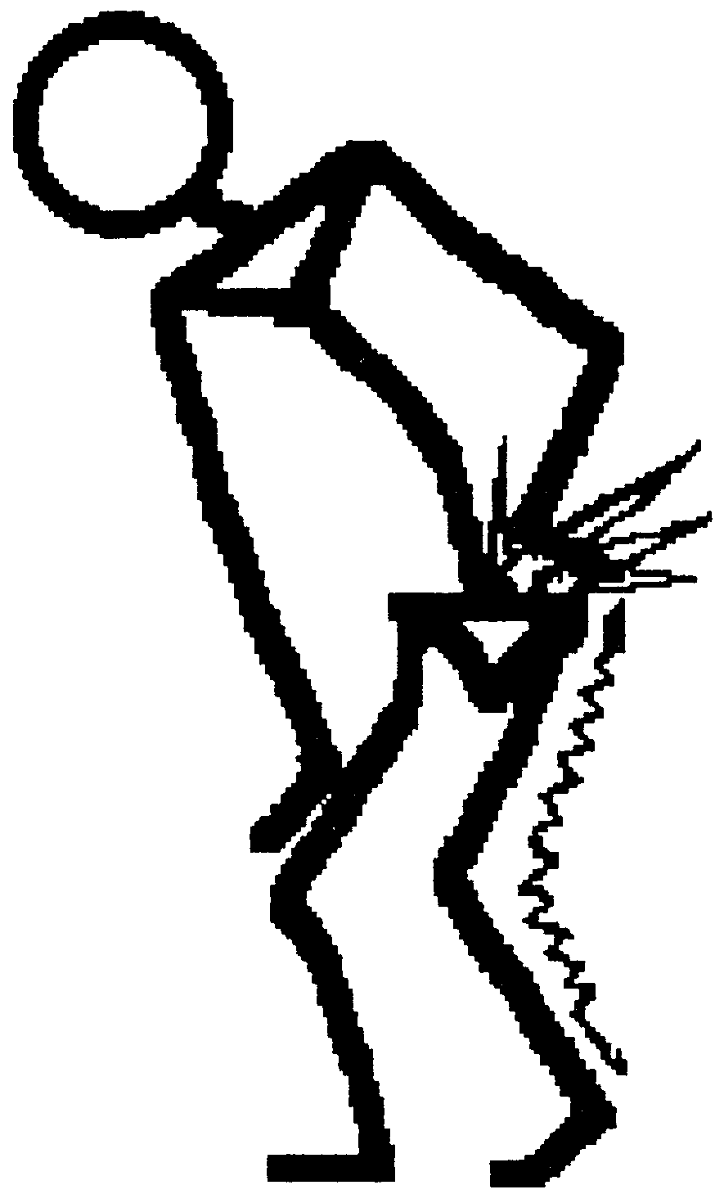
How does the pain feel?
Tingling (like pins and
needles)
Shoots through a part
of the body
Notes:
Pain from a headache or urinary tract infection may be throbbing or stabbing, while pain from nerve irritation is likely to be burning, shooting, or tingling. Pain from arthritis and joint problems is often aching.
Examples of other terms to describe pain include– searing, knife-like, sharp, twisting, scorching, stretching, jabbing, etc.

Slide 18
How much does it hurt?
Ask the resident to rate their pain by pointing to the face or responding to the description.
No pain
Very much pain
Notes:
The Faces Pain Scale is one tool that can be used to have residents rate their pain. You can show them the picture of the faces and have them point to the one that most accurately illustrates the amount of pain they are experiencing. You can tell them that the first face is no pain and the last face is the worst pain imaginable. Sometimes persons with dementia or severe communication problems can rate their pain using this method.

Slide 19
How much does it hurt?
Another approach to determining how badly the person hurts is the numeric scale shown below.
Notes:
The Numeric Pain Distress Scale is another approach to having people rate their pain. People who are able to communicate verbally and are alert will do best with this test. Make certain to ask people what their pain is “right now”, what is it at its worst, and what level of pain is acceptable.

Slide 20
Where is the pain?
Ask the resident to tell you or point to where they hurt.
If they say they hurt all over, ask if it is worse in one place.
Ask if the pain is deep in the body or near the outside.
Notes:
The diagram to use for assessing the area of the pain is in the handouts.

Slide 21
Duration of the pain
How long has the person been in pain?
Does it come and go or is it constant?
How long does the pain usually last?
Notes:
It is important to know how long the person has been in pain. This may give a clue about the cause or type of pain. It is important to catch pain early and treat it before it becomes severe. Medication and other approaches to managing pain are most effective before pain becomes severe.
Knowing whether the pain is constant or comes and goes provides a clue to the type of pain. Some types of pain, particularly nerve pain, may occur for only short periods and resolve without treatment. Other times it can be constant and unremitting. Joint pain can be constant and aching or may be present only with movement.
The length of time pain lasts is a clue to the cause. It is also important to know how long it takes for the pain to subside or be reduced after a pain treatment or medication is given. The person needs to be reassessed 30 to 45 minutes after medication or other treatment is given to assure it is effective.

Slide 22
What makes the pain worse?
Movement
Walking
Standing
Reaching
Heat
Cold
Notes:
Pain can vary with movement, certain activities, temperature, humidity, and other things. Sometimes people will not be in pain if they are sitting quietly or lying down. However, they may have considerable pain if they do certain movements or stand up and walk. While heat and cold can help some kinds of pain, it can cause pain in certain conditions. For example if people have cold intolerance, going outside on a cold day can cause severe pain. Heat can exacerbate pain in certain neurological conditions, such as multiple sclerosis.

Slide 23
What (if anything) makes the pain better?
Change in position
Heat, cold, vibration, massage
Certain medication(s)
Notes:
There are many nondrug approaches to managing pain. Occasionally they are effective alone in relieving pain or are helpful in increasing the speed and effectiveness of drug interventions for pain. Medications should be the first line of treatment for severe pain, but nondrug approaches may increase the effectiveness of medications regardless of the level of pain.

Slide 24
Assessing Pain in Residents Who Cannot Tell You How They Feel (or will not admit to having pain)
Notes:
Have participants think about a resident that they have cared for that they knew was in pain, but the person could not tell them about the pain. Ask them to describe how they knew the person was having pain. What signs of pain did they observe? Write the responses on a flip chart and post each sheet for all to see. When all responses have been recorded, go to the next slide.

Slide 25
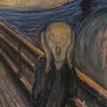
Non-Verbal Signs of Pain
Confusion
Agitation
Restlessness
Notes:
Many times people who are confused, have dementia, or experience language difficulties cannot tell you through language that they are in pain. The signs of pain that are important in these individuals are behaviors or changes in behaviors. Anytime an older adult suddenly becomes confused or has an increase in their confusion, you need to consider pain as a cause. The most common causes of confusion in older adults are infection, dehydration, and pain.
Agitation and restlessness may also be indicators of pain or discomfort. The individual may have discomfort from a urinary tract infection, pain from an undetected fracture or other conditions that are causing distress.

Slide 26
Non-Verbal Signs of Pain
Guarding
Grimacing
Moaning/crying/yelling
Irritability/
swearing
Notes:
Anytime a resident grimaces or appears reluctant to move or guards a part of the body upon movement, suspect that pain may be the cause. Though there can be many reasons for moaning, crying and other verbalizations, pain or discomfort are common culprits. Attempt to determine if there are obvious causes for or areas of discomfort– poor positioning, swollen joints, too cold, too hot, etc.

Slide 27
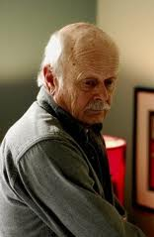
Non-Verbal Signs of Pain
Appetite and activity changes
Unusually quiet
Not participating in usual activities
Notes:
Sometimes the signs of pain and discomfort are more subtle. Unwillingness to eat, refusal to participate in activities, being usually quiet, or physically striking out at caregivers can all signal pain.
Give participants copies of the PainAD scale and go over the indicators of pain in each category.

Slide 28
How You Can Help with Pain Management

Slide 29
What to do if you think a resident is having pain-
Gather as much information as possible.
Report specific signs of pain to the nurse.
Try simple and safe nondrug strategies- divert attention with conversation, singing, repositioning, touch.
Document what you see.
Document what helps.
Notes:
If a resident you are caring for has pain, gather as much information as possible and report it to the nurse. If the resident is able to answer, ask the questions shown earlier– the type of pain, intensity, location, duration, what helps and what makes it worse?

Slide 30
QUESTIONS?

Slide 31
Go to Module 2-- Nondrug Therapies

